Slide 1


Leading WSU Strategic Vision
Fostering an Excellence-based Culture
Notes:
Slide 1
Key Learning Points:
Session Title
Actions:
Welcome Participants
Thank everyone for attending & share your anticipation of a valuable session with their active participation
Time 1 min

Slide 2
Agenda
Fostering an Excellence-based Culture
Objectives:
Understand our roles in supporting an effective cascade of the 2016-2021 Strategic Plan
Align S/C/Ds with WSU Vision/Mission/Values
Prepare leaders and individuals to embrace and lead change
Strategic Plan Review 15 min
Envisioning a Compelling Future 30 min
Values in Action 30 min
Our Roles – Making Change Happen 20 min
Toolkit and Support 15 min
Commitments and Next Steps 10 min
Total 120 min
Notes:
Slide 2
Key Learning Points:
We all have a role in creating an Excellence-based culture at WSU
This session will help us lay the ground work for aligning our activity and collectively living our values
Our ultimate goal is creating positive experiences for each other, and exceptional outcomes for our students
Actions:
Review Objectives and Agenda Items
Review any needed Logistics & “Housekeeping” items as needed (specific to your session)
Silence cell phones, bathrooms, food & beverage, breaks, etc.
Time 5 min

Slide 3
Strategic Plan Review
By 2021, “Distinctively Wayne State” will result in a thriving institution known for academic and research excellence, where every student has a clear pathway to success and the opportunity to flourish in a diverse, collaborative and innovative environment. Through its commitment to research and community engagement, Wayne State will continue to be recognized as a leader in Detroit’s revitalization and will grow its reputation for understanding and addressing urban challenges.
Notes:
Slide 3
Note: Slides 3-16 provide a high-level overview of the 2016-2021 Strategic Plan. There is 15 minutes allotted for this entire section – that’s about a minute for each slide.
Key Learning Points:
These words integrate our mission, vision and values into one statement that unites us in a shared purpose. It reminds us of what we will be known for, the positive impact we will make for our students and the communities we serve, and how we will get there.
Actions:
Read statement / optional: ask a participant to read
Refrain from diving deep into each statement – just begin to create awareness
Relate the Key Learning Points (use your own “voice”)
Say, “Now, let’s look at each of those elements, one at a time.”
Time 15 Min (Total time for entire Strategic Plan Review)

Slide 4
WSU will be a pre-eminent, public, urban research university known for academic and research excellence, success across a diverse student body and meaningful engagement in its urban community.
Notes:
Slide 4
Slides 3-16 provide a high-level overview of the 2016-2021 Strategic Plan.
Key Learning Points:
Our Vision is what we will be known for. It is a picture of the future, meant to rally us around a common purpose and guide our actions.
Actions:
Read statement / optional: ask a participant to read
Relate the Key Learning Points (use your own “voice”)
Highlight key words that may be new, more meaningful for your S/C/D
Time 15 Min (Total time for entire Strategic Plan Review)

Slide 5
Wayne State’s mission is to create and advance knowledge, prepare a diverse student body to thrive, and positively impact local and global communities.
Notes:
Slide 5
Slides 3-16 provide a high-level overview of the 2016-2021 Strategic Plan.
Key Learning Points:
Our Mission is what we do on the road to realizing our Vision.
Actions:
Read statement / optional: ask a participant to read
Relate the Key Learning Points (use your own “voice”)
Highlight key words that may be new, more meaningful for your S/C/D
Time 15 Min (Total time for entire Strategic Plan Review)

Slide 6
While our vision and mission show where we want to go, our values guide us on the way. They cut across organizational boundaries, bind us culturally, and permeate our strategic and tactical initiatives. They are the defining traits of the Wayne State community.
Notes:
Slide 6
Slides 3-16 provide a high-level overview of the 2016-2021 Strategic Plan.
Key Learning Points:
Our Values are “how” we get there, they guide our behaviors help us shape our culture.
Actions:
Read statement / optional: ask a participant to read
Relate the Key Learning Points (use your own “voice”)
Say, “Let’s take a look at the WSU Values…” or similar
Time 15 Min (Total time for entire Strategic Plan Review)

Slide 7
Our WSU Values
Collaboration When we work together, drawing upon various talents and perspectives, we achieve better results.
Integrity We keep our word, live up to our commitments and are accountable to ourselves and each other.
Innovation We are unafraid to try new things and learn by both failure and success.
Excellence We strive for the highest-quality outcomes in everything we do.
Diversity and Inclusion We value all people and understand that their unique experiences, talents and perspectives make us a stronger organization and better people.
Notes:
Slide 7
Key Learning Points:
Five Values have been identified to help us build a culture of excellence – where everyone feels valued, can contribute fully and collaborate at the highest levels.
Today, we’ll build our awareness of these values, explore how they resonate for us personally, and identify how they link to our goals.
Actions:
Review each Value
Time 15 Min (Total time for entire Strategic Plan Review)

Slide 8
Strategic Focus Areas
Seven strategic focus areas guided our planning. In each of
these areas, we’ve identified essential goals to achieving the
“Distinctively Wayne State” student experience.
  ^{Student Success}
  ^{Teaching Excellence}
  ^{Diversity and Inclusion}
  ^{Community Engagement}
  ^{Research}
  ^{Entrepreneurship}
  Financial Sustainability and Operational Excellence
Notes:
Slide 8
Key Learning Points:
Our Mission, Vision and Values provide the roadmap for where we’re going and how we’ll get there.
These seven Strategic Focus Areas help us align our activity to achieve the “Distinctively Wayne State” student experience
Actions:
Review the focus areas quickly
Say, “Let’s take a look at each of these areas and the goals associated with each one.
As we review them, think about how our goals and strategic plans might support each one”
Time 15 Min (Total time for entire Strategic Plan Review)

Slide 9
Student Success
Students are our top priority, and we provide them with the tools and experiences that they need to learn and to succeed. Academic excellence, innovative pedagogies, collaborative and interdisciplinary research, career preparation, global experiences, and deep engagement in cultural diversity within a dynamic urban environment all create a “Distinctively Wayne State” student experience.
Our goals for this strategic focus area are:
  Cultivate a culture of student success
  Create clear academic pathways that support progressive student success
  Increase retention, progress to degree and graduation rates for all students
  Enhance academic and career training for all graduate students
Notes:
Slide 9
Key Learning Points:
Student Success is our top priority.
Actions:
Review definition and goals
Time 15 Min (Total time for entire Strategic Plan Review)

Slide 10
Teaching Excellence
We will use proven and innovative, evidence-based,
high-impact practices and culturally responsive and reflective pedagogies to increase levels of student engagement and learning outcomes.
  Our goals for this strategic focus area are:
  Enhance a culture that values teaching excellence
  Identify and encourage the adoption of best teaching practices and the improved delivery of learning outcomes campus wide through the use of data
  Improve the quality of faculty-student relationships
  within the classroom and beyond
  Improve graduate student training and mentoring
Notes:
Slide 10
Key Learning Points:
Increased student engagement and quality of faculty-student relationships are cornerstones of driving Teaching Excellence.
Actions:
Review definition and goals.
Time 15 Min (Total time for entire Strategic Plan Review)

Slide 11
Diversity and Inclusion
We strive to have an inclusive environment where diversity is valued broadly and every person has the opportunity to contribute and succeed. Our rich multicultural experiences reflect the real world and help develop leadership in a global society.
  Our goals for this strategic focus area are:
  Leverage our diversity to create an inclusive campus
  where every group and individual feels valued
  Implement and enhance academic programs focused
  on cultural, language and global competencies
Notes:
Slide 11
Key Learning Points:
We pride ourselves on being one of the most diverse campuses in the nation, and will continue to provide a rich environment for students to learn and grow in, so they are prepared to interact and lead in a global society.
Actions:
Review definition and goals.
Time 15 Min (Total time for entire Strategic Plan Review)

Slide 12
Community Engagement
We encourage every faculty member, administrator and
student to participate in meaningful, sustainable and mutually beneficial relationships with our community. We believe that experiential learning and community service are vital to our academic mission.
  Our goals for this strategic focus area are:
  Continue to enhance our leadership in the revitalization
  of Detroit
  Develop innovative, meaningful, sustainable and mutually beneficial community-based service-learning experiences
  Maintain and enhance the university’s institutional reputation of high-quality community engagement
Notes:
Slide 12
Key Learning Points:
Community engagement is vital to our academic mission, and the city’s sense of renewal.
Actions:
Review definition and goals.
Time 15 Min (Total time for entire Strategic Plan Review)

Slide 13
Research
We are committed to ensuring that Wayne State University becomes a world leader in discovery and knowledge application. We will increase strategic, integrative research and nurture the broad ecosystem for scholarly inquiry, discovery, creativity and knowledge application by leveraging our academic strengths, community engagement mission and urban location
  Our goals for this strategic focus area are:
  Nurture and expand the research and discovery mission
  Develop the infrastructure and processes necessary to support research, knowledge application and broad programmatic initiatives
  Grow research-based revenue
  Enhance our “Distinctively Wayne State” pipeline of student researchers
  Communicate and expand awareness of excellence
  in research, discovery and knowledge application
Notes:
Slide 13
Key Learning Points:
Our reputation as a leading research-based university will continue to expand to make a positive difference in people’s lives.
Actions:
Review definition and goals.
Time 15 Min (Total time for entire Strategic Plan Review)

Slide 14
Entrepreneurship
Our university will become a bustling hub of innovation, where new ideas are constantly developed into new ventures; students and faculty collaborate through TechTown Detroit to mentor community, urban, and minority entrepreneurs; and industry leaders and startup CEOs seek innovative resources.
  Our goals for this strategic focus area are:
  Create a thriving culture where new ideas and new ventures are consistently developed and rewarded
  Simplify, coordinate and enhance the process of innovation and entrepreneurship
Notes:
Slide 14
Key Learning Points:
The pace of technological advances and a competitive global economy dictate increasing innovation and entrepreneurship.
Actions:
Review definition and goals.
Time 15 Min (Total time for entire Strategic Plan Review)

Slide 15
Financial Sustainability & Operational Excellence
We commit to growing revenue and increasing the efficiency and effectiveness of business processes in order to provide adequate resources to support the university’s mission.
  Our goals for this strategic focus area are:
  Increase enrollment
  Develop a culture of philanthropy throughout the
  university community
  Diversify and enhance sources of revenue
  Achieve operational excellence in all processes
  Ensure environmental sustainability
Notes:
Slide 15
Key Learning Points:
The “Distinctively Wayne State” experience can only be delivered with an operational model of efficiency and sustainability.
Actions:
Review definition and goals.
Time 15 Min (Total time for entire Strategic Plan Review)

Slide 16
To view the complete strategic plan, visit
wayne.edu/strategicplan
Notes:
Slide 16
Materials: Copy of 2016-2021 Strategic Plan
Key Learning Points:
This is a quick overview of our 2016-2021 Strategic Plan. A copy of the full plan can be found at this address.
The President’s address video can be viewed at (provide link when available)
Actions:
Show Plan; Reiterate that a full detailed plan can be downloaded at the address on the slide. Also, the President’s address can be viewed at [Link]
Say, “With this initial understanding at the University level, let’s delve a little deeper into what this Plan means for us.”
Time 15 Min (Total time for entire Strategic Plan Review)

Slide 17
Envisioning a Compelling Future
Today @ Wayne Activity
Imagine that it is the year 2021, and Today @ Wayne is featuring your group in an article.
Individual Work (5 min): Write a brief headline and student/customer quote that you would like to see published as a result of your group’s efforts.
Table Teams (10 min): Share at your table and look for common themes/outcomes
Identify which Strategic Focus Areas these successes align with?
Which values were key to achieving goals?
Select a spokesperson to report out on what they learned (1 headline, quote, strategic area and value)
Group Discussion (15 min): Capture thoughts
Notes:
Slide 17
Optional Activity: Today @ Wayne Activity / Purpose: Help participants envision future outcomes in their Unit, see how they align with WSU Strategy and begin to link values
Materials:
Headline/Quote Worksheet
Flip chart & markers
Key Learning Points:
Painting a picture of the future helps create shared purpose, enables alignment with WSU Strategic Plan and guides our decision-making
Being able to connect our values to positive outcomes helps us realize why they are important and build a business case for change
Actions:
Say, “Now that we have a sense of the University's direction, we can see how our goals and objectives align with the WSU Strategic Plan.
To do that, we have an activity to help us envision what that future might look like for us.”
Review the activity before handing out Worksheets
The Individual and Table Team portion should take about 15 minutes
Walk around during activity to gain insight on team discussion, answer questions and make sure the teams are on task
Give a 2 minute “heads up” so that teams can finish up their discussion and appoint a “spokesperson” if they haven’t already done so
Bring group back together and have each table report out their headline, quote, Strategic Focus Area and important values
Debrief activity (about 15 minutes) – capture group’s key learning, common themes, importance of values and how they link to outcomes, and other insights on flip chart
Time 30 minutes for entire activity

Slide 18


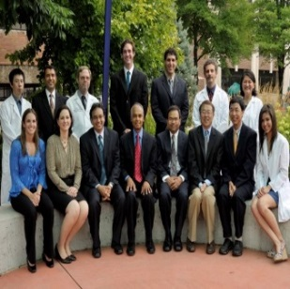

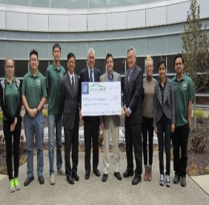


Linking Values to Strategic Goals
Values
S/C/D Goals & Objectives
Headlines, Quotes, Outcomes
Strategic Goals
Collaboration
Innovation
Diversity & Inclusion
Integrity
Excellence
Fill in Unit goals & objectives
Student
Success
Community
Engagement
Fill in Unit goals & objectives
Teaching
Excellence
Fill in Unit goals & objectives
Entrepreneurship
Research
Financial
Sustainability
Diversity & Inclusion
Notes:
Slide 18 Customize Prior to Session with some examples of Unit goals and objectives. Use examples from the Today @ Wayne Activity to show how these align with 1 or 2 of the WSU strategic areas, and how values enable these goals. Refer to “Planning & Readiness” section of Toolkit for more tips on creating Impact Maps and Linking Values to Strategic Goals.
Key Learning Points:
This visual helps demonstrate how Unit goals & objectives align with WSU Strategic Areas, and helps us describe how values enable us to achieve those goals.
Values are a key enabler to achieving University, School, College and Division strategic goals, as well as producing positive outcomes for each other, our students and the community at large.
Actions:
Transition from previous activity; Say, “With these future states in our sights, let’s look at how these align with the WSU Strategic Focus areas and how some of our Goals and Objectives will support them”
Use examples from the de-brief as well as some pre-filled in examples to show alignment with WSU Strategic goals
Ask is there alignment? What changes may need to be made?
What are the implications for the Unit with regard to priorities, working together?
Time 30 minutes for entire activity

Slide 19
Values in Action
Digging Deeper: Team Activity
Table Teams (15 min): Answer questions based on your selected Value
Why is this Value important to the way our team operates and in our ability to meet the needs of those we serve?
What is coming down the pike that will make it especially important to excel in this value?
What’s one thing we do well now to live this?
What would it look like if we weren’t living this Value?
What would be the impact on our colleagues, community, students?
What can we do if we notice someone not living the values?
Group Discussion (15 min): Capture thoughts
Notes:
Slide 19
Values in Action Activity / Purpose: Based on previous activity, identify and deepen understanding of Values that are important to the team, find personal meaning, and share thoughts on impact of ‘not living’ values, as well as ways to support each other
Materials:
Values Worksheet
Key Learning Points:
Values help us build a culture of excellence by guiding our behaviors and performance expectations
They help us focus on the experiences we create for each other and the impact we have on our stakeholders
They unite us, but are expressed and experienced in many different ways
Actions:
Say, “Let’s dig a little deeper to explore what the Values mean to us personally and as a team”
Assign each table a value and give them a Values Worksheet to help them explore their thoughts
Tell them to answer questions as a group and select a different spokesperson to report out during the Group de-brief
Give them about 15 minutes to discuss, with a 2-minute “heads up”
Walk around to get a sense of the discussions, answer questions and keep teams on task
Debrief activity - capture group’s key learning, common themes, pull out any action items/commitments/change that has to occur as a team or individually to support living the Values
Time 30 minutes for entire activity

Slide 20

Our Roles – Who is Responsible?
Notes:
Slide 22
Materials: flip chart & markers
Key Learning Points:
Everyone is capable of living our values without anything else happening after today - Use the metaphor of the Ripple Effect – one small action (one individual) can have a positive (or not-so-positive) impact on many – but alone is very hard! Imagine dozens, hundreds of these ripples – what happens then?
Living our values requires awareness, commitment and ongoing engagement from everyone – we all play a role in embedding our values into the WSU culture
One of the biggest reasons why change initiatives fail: lack of authentic leadership championship and lack of pervasive, ongoing engagement. Leaders play a critical role, but all of us, regardless of our “title” are responsible (and have the ability) to lead by example, positively influence others and make significant impact
Actions:
Ask, “Who is responsible for embedding our values into the WSU culture?”
Say, “The answer is everyone! We each play a role in getting our values ‘off the paper’ and into action”
Brainstorm some of the responsibilities of leaders, as a team and as individuals in making this happen?
Capture on flip chart
Summarize Key Learning Points
Time 5 min

Slide 21
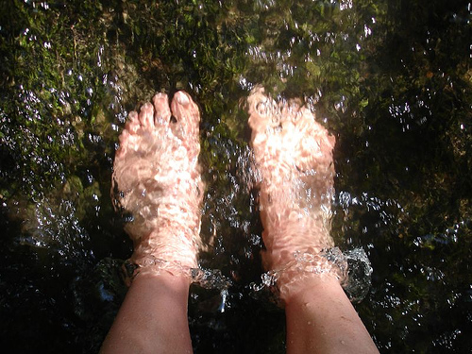
You Can’t Step in the Same River Twice
Notes:
Slide 21
Key Learning Points:
You can’t step in the same river twice because it is always flowing, always changing
To live our Values, we must be prepared to make changes as well – changes in how we do things, the way we approach our work, what we focus on, our skills, abilities and knowledge
We don’t expect change to happen overnight, it takes time and is an ongoing effort
Actions:
Ask the team what this saying means to them: “You Can’t Step in the Same River Twice”
Say, “As we take on our roles, we do so in an environment of change”
Refer back to any examples the team identified in previous activities that drive the need for change to achieve their 2021 vision
Say, “So what will it take to get from here to achieving the headlines and student quotes we envision for 2021?”
Time 2 min

Slide 22
Our Roles – Working Together to Make Change Happen
Planning & Readiness
Communication & Engagement
Implement & Sustain Change
Generate Awareness
Link to Outcomes /Build Case for Change
Commit & Set Direction
Communicate
Enable & Empower Others to Act
Create Short-term Wins
Monitor & Adjust; Use Data to Learn
Align Systems & Processes
Embed into Culture – Continue Cycle
Strategic Operational Tactical
Leaders Personalize, Readies self & team Leads Cascade, Supports Action Plans, solicits Monitors activity and outcomes
for change, builds case, aligns team feedback ,Reinforces behaviors that embody Provides data to team and other Models behavior, shares openly values ,participates in activity, integrates into leaders, process improvements
Determine measures of success team practices, reward & recognition
Individuals Personalize, Readies self for Creates Action Plans, provides feedback Use data to learn and make change, aligns own behavior Recognizes behaviors that embody values, improvements
shares openly participates in activity
Marketing Develops Messaging & Implements Communication Strategy Tracks progress
Communication Strategy Supports training efforts Reports successes & makes Develops materials recommendations
HR / OED Develops Learning Strategy Supports communication strategy Tracks progress
Supports Cascade Meetings Supports and/or facilitates sessions Reports successes & makes Supports leader & individual Supports reward & recognition efforts recommendations
development Supports development Supports process improvements
Notes:
Key Learning Points:
Change happens over time, not overnight
It is a continuous cycle, not a one-time event
We play a role in every phase, but we’re not alone – we have a road map and support along the way
Actions:
Review each of the stages of change (top graphic – first animation
Review each of the roles, and some of the types of activity that occurs – second animation
Point out how examples from the previous brainstorm activity are captured here
Ask team, “So, Where are we right now?”
Time 5 min

Slide 23
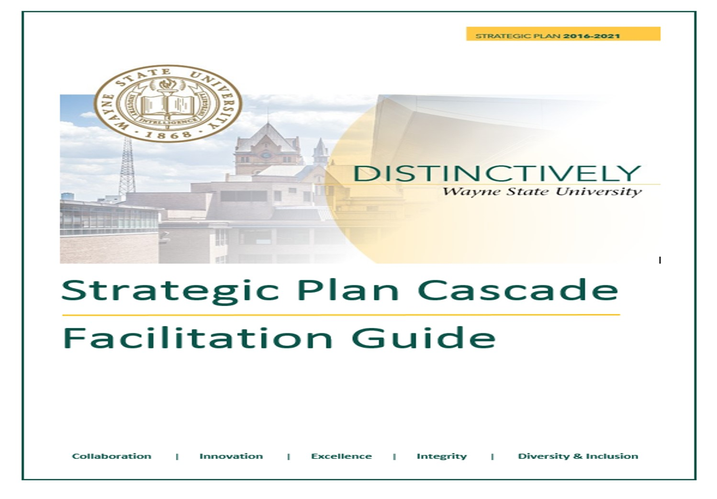
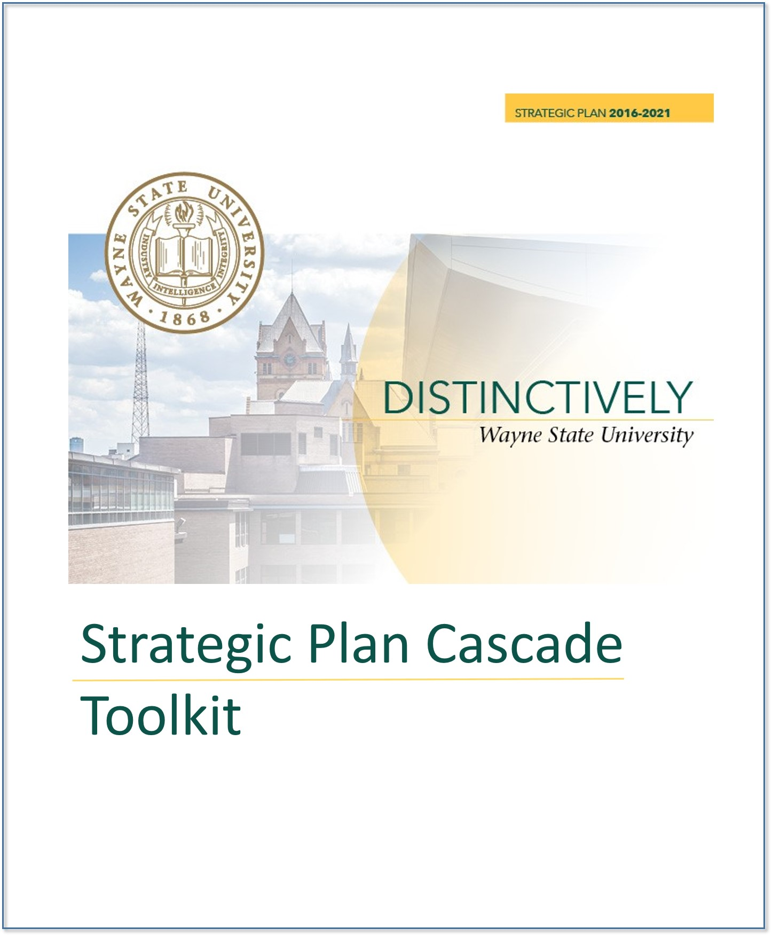
Facilitation Guide & Toolkit
For now…
For later…
Notes:
Slide 23 Materials: Copies of Facilitation Guide and Toolkit
Key Learning Points:
These cascade sessions are part of our readiness activity and the beginning of our communication efforts
The Facilitation Guide will support the Cascade Sessions – It contains everything you need to prepare for and facilitate your Session
The Toolkit contains additional activities and resources that support each phase
Actions:
Show Facilitation Guide (For Now) and Toolkit (For Later)
The Facilitation Guide created for WSU leaders at all levels to support the cascade of the 2016-2021 Strategic Plan throughout their S/C/Ds
It contains materials, checklists, preparation exercises and activities to customize content, as well as support resources and contact information to help with preparation and facilitation
The Toolkit contains additional resources and materials to build engagement and sustain momentum over time
It will help managers and individuals navigate and lead change
Time 5 min

Slide 24

Next Steps & Commitments
Schedule Cascade Sessions
Take Today’s Input Forward
  What will it take?
  What does it look like?
  How will we track & support?
Commitment is what transforms a promise into reality
Abraham Lincoln
Notes:
Slide 24
Materials:
“Commitment poster”
Camera/Phone for team photo (optional)
Key Learning Points:
Gain clarity about next steps – Continue Cascade Meetings
Identify actions for leaders, team, individuals
Get commitment on 1 important thing (SMART)
Identify how the team will track and support progress
Have team sign and date
Take team photo; send copy to Marketing (Christa Clark Raju ccraju@wayne.edu)
Actions:
Review next steps
Create a Commitment Parchment with signatures
Thank participants for their candid conversation and input, and express enthusiasm/expectations for continued work together
Time 10 min

